Slide 1


Motor learning: An overview of methods and models
20 September 2016
David J. Herzfeld
Johns Hopkins University
Department of Biomedical Engineering
Laboratory for Computational Motor Control
Tutorial: Learning at the interface of vision and oculomotor control

Slide 2
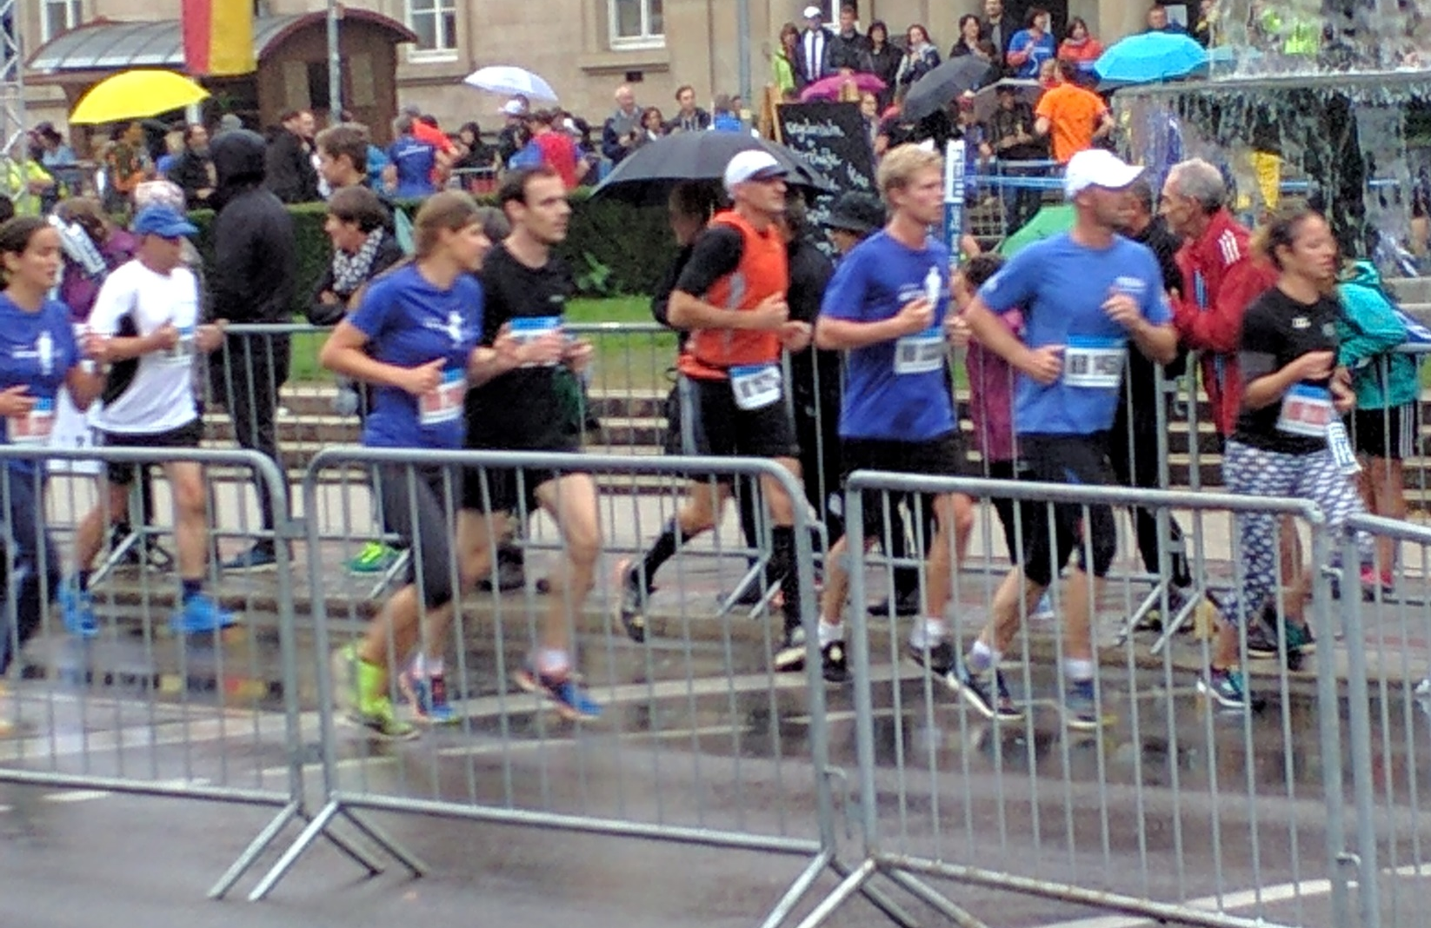
A race in Tübingen

Slide 3
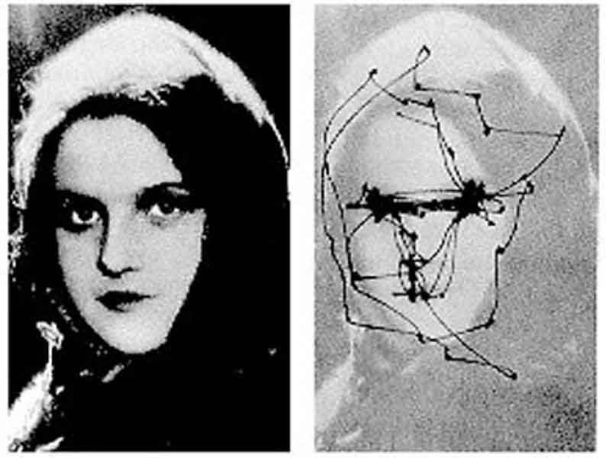
Saccades (rapid eye movements) direct the fovea to points of visual interest multiple times per second.
16
14
15.0 deg
12
10
10.0 deg
8
Position (deg)
6
4
5.0 deg
Saccade kinematic parameters (e.g., velocity and duration) increase with increasing saccade amplitude
2
0
-20
0
20
40
60
80
100
120
600
500
15.0 deg
400
300
10.0 deg
Velocity (deg/s)
200
5.0 deg
100
0
-20
0
20
40
60
80
100
120
Time (ms)
Yarbus (1965)

Slide 4
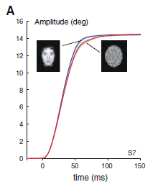
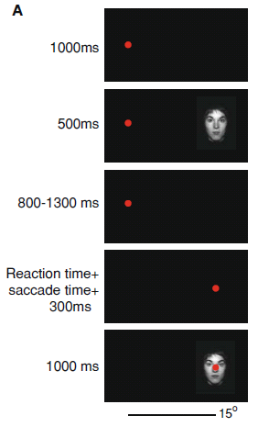
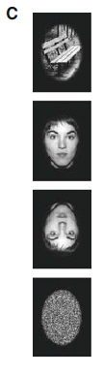
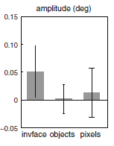
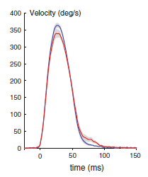
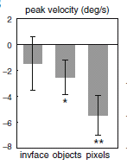
To enable accurate movements, the brain must be capable of making predictions
Xu-Wilson et al., 2009

Slide 5
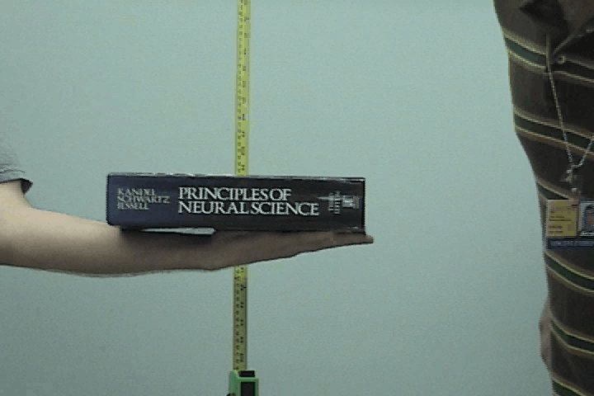
The forward model in action – predicting sensory consequences

Slide 6
Predicting sensory consequences – the role of the forward model
force
State change
Motor commands
Muscles
Body part
Measured sensory
Sensory system
ference copy
consequences
Integration
(delayed)
Proprioception
V
ision
f
Audition
E
Predicted sensory
consequences
Forward model

Slide 7
A forward model predicts the sensory consequences of an action
In order to compensate for delays in feedback, the brain must make predictions about the consequences of our motor commands (a forward model).
A forward model allow humans to precisely control an effector when sensory inputs are delayed (e.g., arm movements) or absent during the movement (e.g., saccades)

Slide 8
The cerebellum appears to be crucial for predictions about the sensory consequences of a movement
force
State change
Motor commands
Muscles
Body part
Measured sensory
Sensory system
ference copy
consequences
Integration
(delayed)
Proprioception
V
ision
f
Audition
E
Predicted sensory
consequences
Forward model
Cerebellum?

Slide 9
The cerebellum predicts sensory consequences (forward model) during saccade execution
Control
Cerebellar
Peak horiz. vel. (% change)
Horiz. amplitude (% change)
Block
Block
The cerebellum appears crucial for forward model computations.
Xu-Wilson et al., 2009

Slide 10

Sensory prediction errors drive motor learning, resulting in forward model updates
The state of our environment and our body is constantly changing. How do we keep our forward model up-to-date?
Sensory prediction error: The difference between the actual sensory consequences and the expected consequences from our forward model.

Slide 11
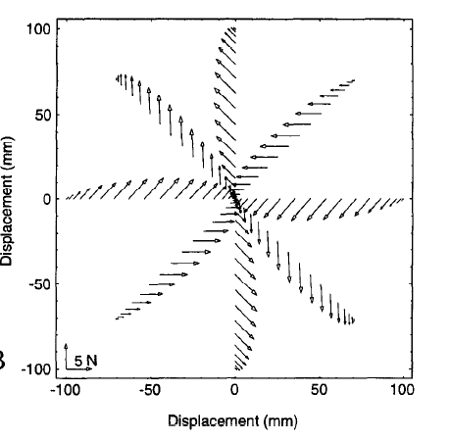


Inducing sensory prediction errors in the laboratory setting: viscous curl fields
b < 0
Shadmehr & Mussa-Ivaldi (1994)

Slide 12
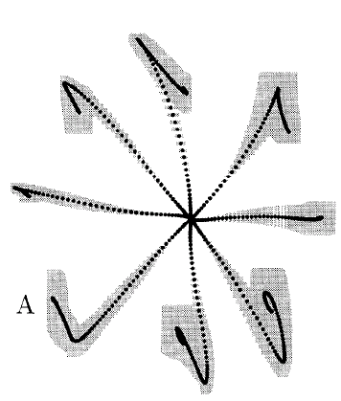
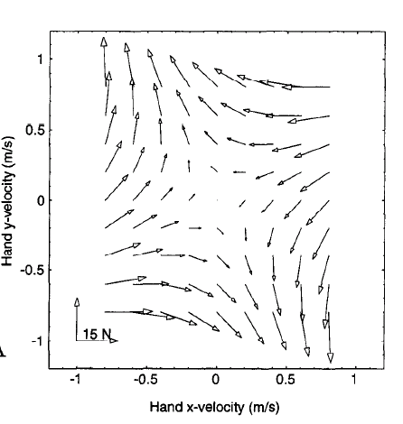
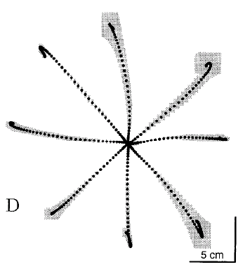
Inducing sensory prediction errors in the laboratory setting: viscous curl fields
First experience of curl field
After 250 presentations
Shadmehr & Mussa-Ivaldi (1994)

Slide 13
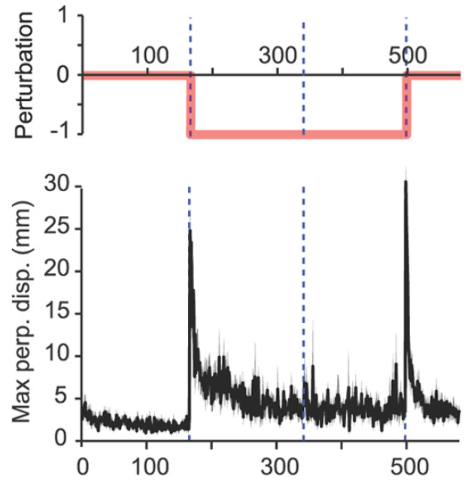
Multi-trial adaptation is well-characterized by exponential function
If a subject experiences the same perturbation repeatedly, they learn to compensate.
Learning of the perturbation is well characterized by an exponential curve
…so is the after-effect
Pekny & Shadmehr (2011)
“After effect”

Slide 14
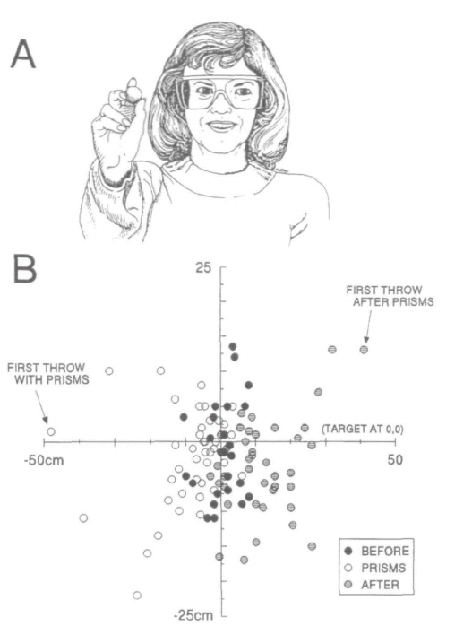
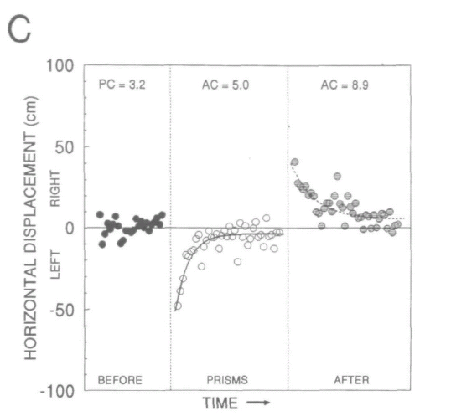
Motor learning occurs even when subjects are aware that their movements are being perturbed
Subject removes glasses
Shift gaze 17°
Even though subjects are aware that they have removed the prisms, there are still after-effects!
Martin et al. (1996)

Slide 15
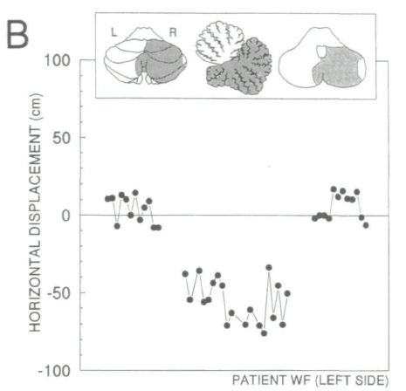

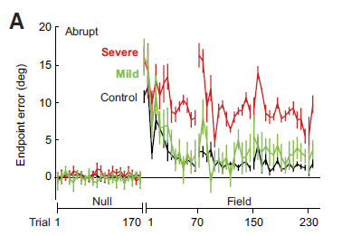
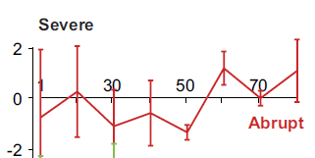
Cerebellar damage impairs error-based learning
PICA Infarct
Cerebellar Ataxia
Learning
No after-effects
After-effects
No learning
Martin et al. (1996)
Criscimagna-Hemminger et al. (2010)

Slide 16
Interim summary
The CNS is constantly receiving feedback about the sensory consequences of our movements. Yet this feedback is delayed and noisy. To overcome these limitations, our brain implements a forward model.
When subjects experience a consistent motor perturbation, over many trials they adapt. This adaptation is exponential. Removal of the perturbation (washout) results in after-effects.
Sensory prediction errors, the difference between the actual sensory consequences and those predicted by the brain, drive learning.
Updating of the internal model seems to depend on the cerebellum. Cerebellar damage results in reduced/no learning and reduced/no after-effects.
Ideally, how should subjects adapt?

Slide 17
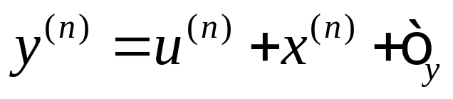
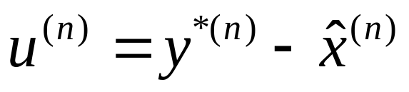
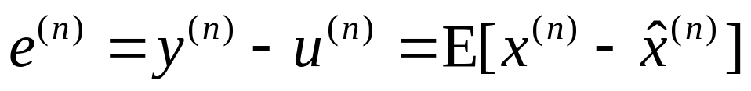
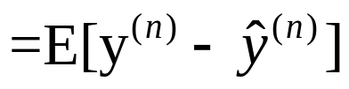
Mathematical description of a forward model
Execution noise
Observation
Perturbation
Motor command
Goal
Estimated perturbation
Error
Observation - prediction
*Sensory prediction error

Slide 18
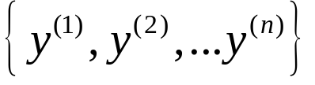

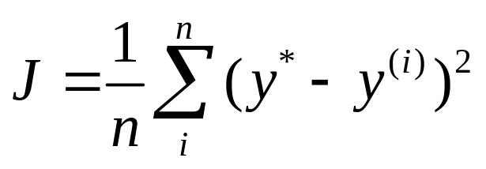
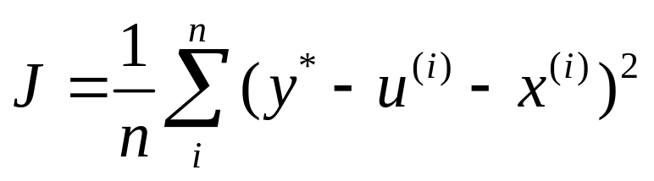
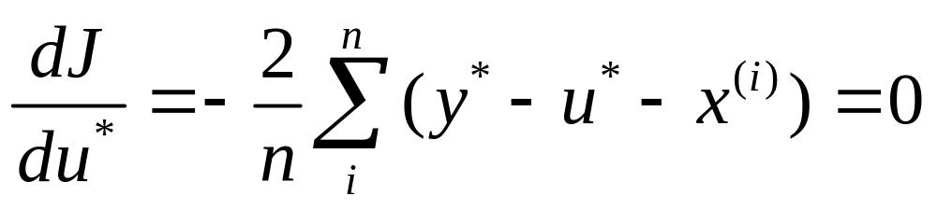
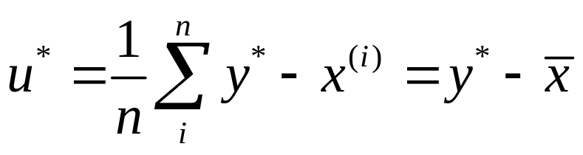
Optimal learning after-the-fact (offline batch learning)
Given our observations:
And our goal:
Cost function
Optimal motor command is the mean of all observed perturbations

Slide 19
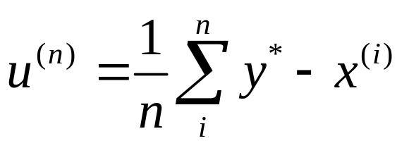
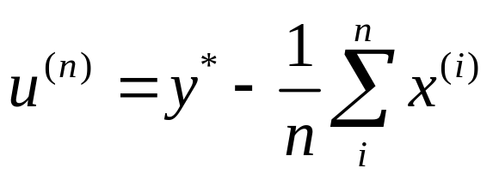
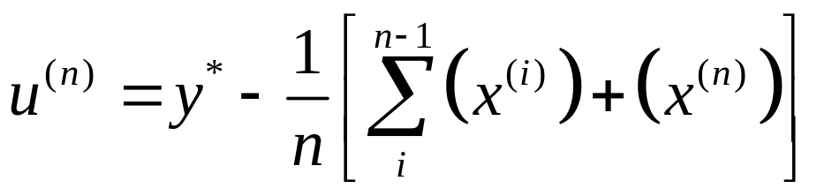
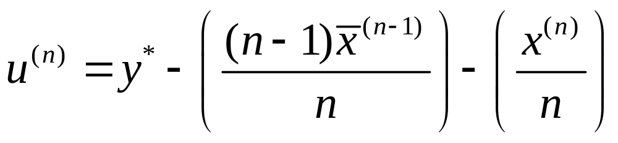
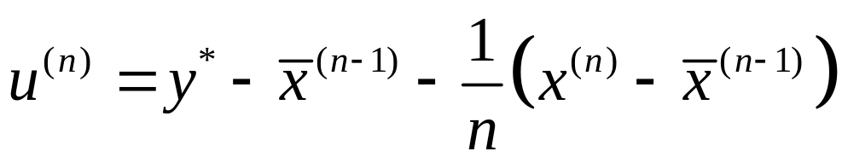
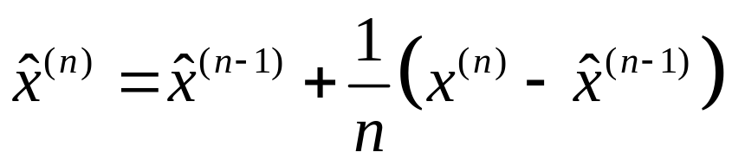
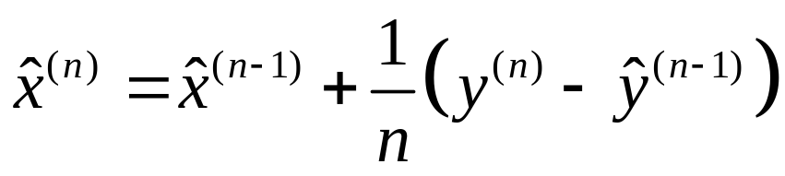
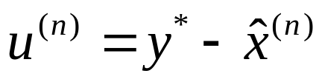
Online learning of a perturbation (‘local’ estimation)
Batch learning requires a long history of trials – what about ‘online’ learning?

Slide 20
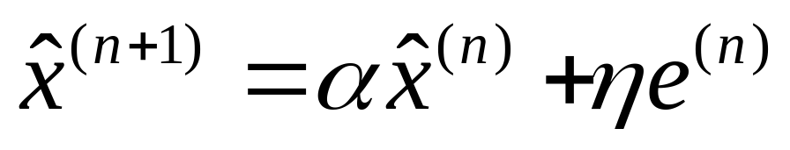

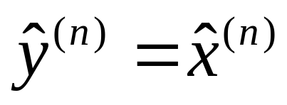
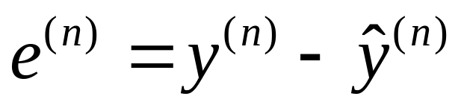
Estimating the perturbation using a single-state model of learning
Estimated state
Error
“Retention” factor
Error-sensitivity

Slide 21



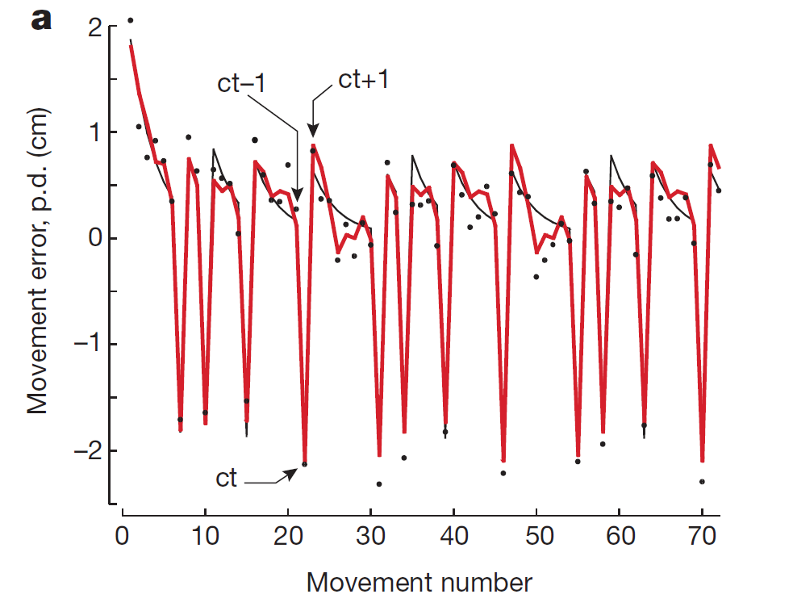
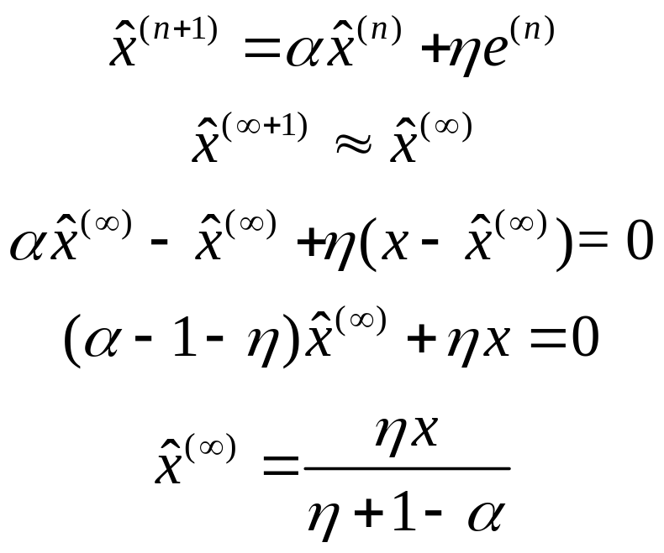
‘Single-state’ model predicts exponential learning and after-effects
After-effects
Baseline
(Null)
Adaptation
Washout
Thoroughman & Shadmehr (2000)

Slide 22
Estimating the perturbation using a single-state model of learning
Estimated state
Error
“Retention” factor
Error-sensitivity
How do we determine our error-sensitivity? Can we adjust it?

Slide 23
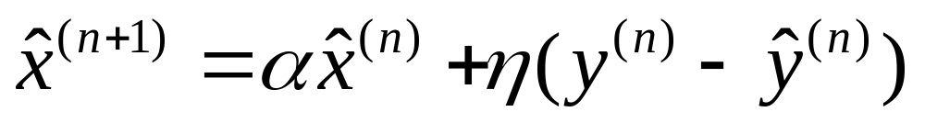

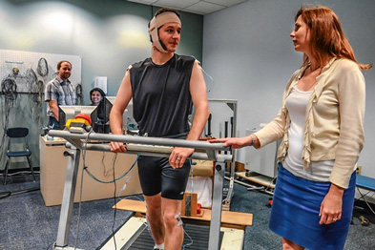

How do we find the error-sensitivity
represents our sensitivity to error, which should reflect something about our confidence of our observations compared to our confidence in our previous estimates.
Parke, KKI

Slide 24
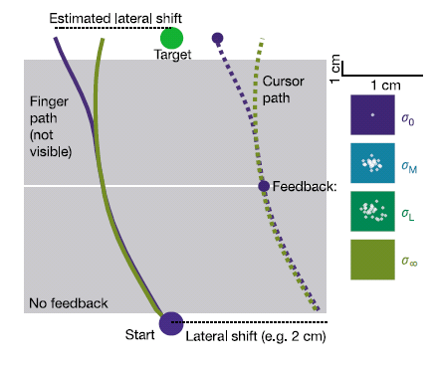
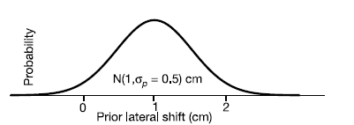
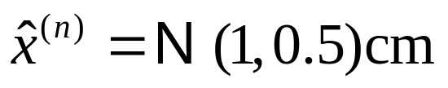
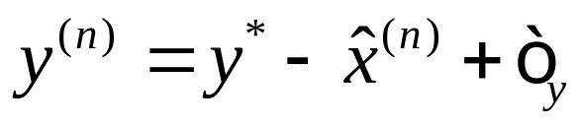
Our estimate of “state of the world” is a combination of what we predict and what we observe
Prior on perturbation:
Distribution of visual feedback
Kording & Wolpert, 2004

Slide 25
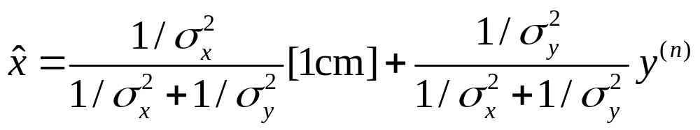
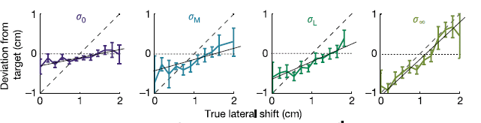
Maximum likelihood integration
How can we optimally combine these two sources of information?
We believe our feedback
We believe our estimate
Kording & Wolpert, 2004

Slide 26

Interim summary
We form predictions about the state of the world via an internal model:
Following an error, we update our belief:
Ideally, error-sensitivity represents our relative confidence in our observations and our state estimate
The world isn’t static –
How can we continuously incorporate our uncertainties?

Slide 27

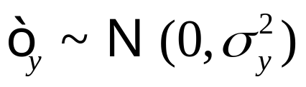





Error-sensitivity and the scalar Kalman filter
Assumption: Our goal is the minimize the uncertainty in our estimate.
Kalman gain

Slide 28

How can we make people faster learners?
Increase state uncertainty
Decrease observation uncertainty
If humans behave in a way that minimizes the uncertainty in their belief about the world, then there should be two ways make people faster learners:
1. Decrease observation uncertainty
2. Increase uncertainty about our belief

Slide 29




Increased observation noise reduces the speed of learning
Kording & Wolpert, 2004
Wei & Kording (2010)

Slide 30

Increased ‘state’ noise (uncertainty in our estimate of the world) increases the speed of learning
Wei & Kording (2010)

Slide 31
Interim summary
The Kalman gain minimizes the uncertainty in our state estimate:
The Kalman gain predicts that we can increase the learning rate of individuals when:
1. We decrease observation noise (e.g., cloud of dots)
2. We increase the state noise (e.g., make people sit in the dark)
In practice, it is difficult to estimate the observation and state uncertainties

Slide 32
Intermission
Break

Slide 33


A note about statistically assessing changes in error-sensitivity
(with intervention)
Do subjects in group 2 (with the intervention) learn
significantly faster than group 1?
There are many ways to answer this question!

Slide 34

A note about statistically assessing changes in error-sensitivity
If each subject is well characterized by an exponential:
1. Fit a single-state model (or exponential) to each subject
2. Using a t-test or one-way ANOVA (if two more groups) to compare the distribution of error-sensitivity values.
?
Assumption: Learning curves are well-characterized by an exponential
(check the fits!)

Slide 35


A note about statistically assessing changes in error-sensitivity
If individual subject data is noisy, but the group data is well characterized by an exponential, then we can use permutation statistics to evaluate group differences.
Null hypothesis
Group 2 mean
Hypotheses:
Null
distribution
Construct random populations (permutations) by choosing subjects from both Group 1 and Group 2
For each of these populations, fit a single-state or exponential model. The eta values form our null distribution.
Compare the eta value obtained for Group 2 to the null distribution.
Our p-value

Slide 36


Assessing the retention rate using ‘error-clamp’ (channel) trials
Adaptation ( ) is a function of both learning from error and ‘forgetting.’
How can we isolate the two processes?
Clamp the error to zero!
(Assuming we know our motor goal)
Benefit: We can measure the forces the subject produces against the channel (in force-field learning).
Scheidt et al., (2009)

Slide 37
Assessing retention using error-clamp trials
Channel period

Slide 38



Changes in retention rate after learning gradual versus abrupt perturbations
Learning a gradually induced perturbation appears to reduce motor ‘forgetting.’
Huang & Shadmehr (2009)

Slide 39
Interim summary
Trial-to-trial adaptation is a combination of two processes: learning from error and forgetting.
During error-clamp trials, we artificially clamp errors to zero, allowing us to assess retention independent of learning from error.
Learning graduate perturbations seem to increase retention (decrease forgetting) compared to learning of abrupt perturbations.
What regions of the brain are involved in these two processes?

Slide 40

tDCS modulates neural excitability
Transcranial direct current stimulation (tDCS) is a non-invasive brain-stimulation technique.
Anodal (positive) stimulation is thought to increase neuron excitability.
Cathodal (negative) stimulation is through to decrease neuron excitability.
Thier et al. (2014)

Slide 41

What brain region is responsible for modifying the rate of adaptation?
We know that the cerebellum is implicated in housing a forward model. Is it required for both learning from error as well as retention?
Herzfeld et al. (2014)

Slide 42

Cerebellar stimulation modulates how quickly subjects learn from error
18
14
Max. perp. disp. (mm)
10
6
2
n2
a1
a3
a5
a7
a9
a
1
1
r1
4
3
2
1
Perp. vel. at 100ms (cm/s)
0
Anodal cerebellar stimulation tends to increase learning, whereas cathodal cerebellar stimulation decreases learning.
-1
-2
-3
n2
a1
a3
a5
a7
a9
a
1
1
r1
Block
Herzfeld et al. (2014)

Slide 43

Cerebellar tDCS does not appear to modulate retention of learned motor memories
Herzfeld et al. (2014)

Slide 44


Introduction of visuomotor rotation experiments
A
30
ANA
Perturbation (deg)
0
Null
Null
Trial

Slide 45


Anodal motor cortex stimulation tends to reduce motor ‘forgetting’
Galea et al. (2011)

Slide 46
Interim summary
Trial-to-trial adaptation is the combination of two processes: learning from error and forgetting.
Cerebellar anodal tDCS, which is thought to increase cerebellar excitability, increased error-sensitivity (faster learning from error).
However, cerebellar cathodal tDCS, which is thought to decrease cerebellar excitability, decreased error-sensitivity (slower learning from error).
Anodal stimulation of M1 results in reduce forgetting (increased retention).

Slide 47

Post-saccadic errors drive short-term saccade adaptation
Error
Ratio of saccade amplitude to target amplitude
McLaughlin (1967)
Straube et al. (2011)

Slide 48
Re-learning of previously learned perturbation results in faster learning (savings)
Error
1.4
1.2
Gain (unitless)
1.0
0
1000
2000
Trial number
Savings: Faster re-learning of a previously learned perturbation
Kojima et al. (2004)

Slide 49
Single-state models cannot account for savings
1.4
1.2
Gain (unitless)
1.0
0
1000
2000
Trial number
A single-state model (even if the Kalman gain is used), cannot account for the phenomenon of savings.
Identical learning
rate
Kojima et al. (2004)

Slide 50

Single-state models cannot account for spontaneous recovery
Spontaneous recovery: Re-expression of a previously learned motor memory following extinction
Kojima et al. (2004)

Slide 51






Multi-rate models of learning (the two-state model)
“Fast” State:
“Slow” State:
The fast state learns quickly but rapidly forgets, whereas the slow state learns slowly but retains what it learns.
Smith et al. (2006)

Slide 52




Learning a constant perturbation using two states
Slow state
Motor output
Fast state

Slide 53

Long-term saccade adaptation exhibits the hallmarks of multiple timescales of learning
Initial learning
Recovery
Robinson et al., 2006
from Kording et al., 2007

Slide 54
Cerebellar tDCS does not appear to modulate retention of learned motor memories
Motor memory transitions from fast to slow state over the experiment.
Herzfeld et al. (2014)

Slide 55

Two-state model predicts savings
Output
Slow
Fast
Savings is driven by the slow state which begins the re-learning period with a non-zero value.
Kojima et al. (2004)

Slide 56



Spontaneous recovery of motor memories can be explained by a two-state model
Channel period
Output
Slow
Fast
Smith et al. (2006)

Slide 57
Interim summary
Single state models cannot account for two important psychophysical phenomena: savings and spontaneous recovery.
Two state models (an instance of multi-rate models) can account for both of these phenomena. Each are driven by the “slow” state, which is non-zero when entering the re-learning/test phase.
Multiple timescales of memory is supported by ‘long-term’ adaptation experiments showing improvements in retention at the end of the learning.
Do these 2+ components of motor memory have separate neural mechanisms?

Slide 58


Change in aiming strategy (visuomotor rotation) results in rapid changes in motor output
“Strategy” target
Mazzoni & Krakauer (2006)

Slide 59


Assaying “implicit” and “explicit” learning of a motor perturbation
Taylor et al. (2014)

Slide 60



Combination of ‘explicit’ and ‘implicit’ learning predict magnitude of after-effects
Taylor et al. (2012)

Slide 61


Implicit learning implicated as ‘slow-state’ and explicit learning as the ‘fast state’
Output
Slow
Fast
McDougle et al., 2015

Slide 62
Interim summary
Trial-to-trial adaptation is a combination of two processes: learning from error and forgetting. Preliminary evidence from stimulation studies suggests that error-based learning is dependent on the cerebellum whereas motor cortex is required for retention.
Multi-state models accurately predict savings and spontaneous recovery.
Recent experimental evidence suggests that (in some tasks) the fast phase may be describe by ‘explicit strategy’ (perhaps dependent on structures in the frontal cortex) and ‘implicit’ learning (perhaps dependent on the cerebellum).

Slide 63
Intermission
Break

Slide 64


Many savings experiments cannot be accounted for by LTI models of learning
Hadjiosif & Smith (2013)

Slide 65


Recent results suggest that error-sensitivity is not “fixed,” but varies as a function of error magnitude
State-space models suggest that error-sensitivity is fixed across error-magnitudes:
Modified from Wei & Körding (2009)
Marko et al. (2012)
Sensitivity (N/cm)
Sensitivity (unitless)
Error (cm)
Visual error (cm)
Question: Does the brain change error-sensitivity within an experiment?
If so, does the brain use a systematic rule for modulating this sensitivity?
Notes:
Force-field adaptation study (left), visual offset perturbation (right)

Slide 66



Do the statistics of the perturbation alter learning rates?
Investigate factors that affect error-sensitivity
Our old ‘single-state’ model of motor learning:
Adaptation
We manipulate the perturbation statistics (altering error history) and observe the change in error-sensitivity ( )

Slide 67


Learning rate appears to be dependent on the statistics of the perturbation
Good preliminary evidence:
Can we conduct a more controlled study?
Smith & Shadmehr (2004)

Slide 68

Does error sensitivity change during an experiment?
Subjects (n=27) made out-and-back reaching movements in one of three environments
z=0.9
stable environment
13
z=0.5
neutral environment
0
Perturbation (Ns/m)
-13
z=0.1
transient environment
30 trials
1-z
z
probe trials
-13
+13

Slide 69

Perturbation statistics modify error-sensitivity
Error-sensitivity
(% ideal/cm)
20
z=0.9 (stable)
15
z=0.5 (neutral)
z=0.1 (transient)
10
z=0.9 (stable)
5
z=0.5 (neutral)
z=0.1 (transient)
0
-5
5
15
25
Block number
Stable environments increase error-sensitivity
Transient environments decrease error-sensitivity
Notes:
Stable, transient, etc.

Slide 70





Interim summary
When an error is likely to persist, people increase their error-sensitivity, and learn more from that error (compared to their original error-sensitivity)
Increases if error
is likely to persist
(stable)
Stable
Transient
Decreases if error
is unlike to persist
(transient)
Stable
Transient
Question: When error-sensitivity changes, does it do so for all error sizes?

Slide 71



Is modulation of error-sensitivity local to experienced errors?
1.2
1.0
z=0.9 (stable)
0.8
0.5
z=0.5 (neutral)
z=0.1 (transient)
0
0.4
Adaptation (cm)
Sensitivity to error (unitless)
-0.5
0
n = 20
z=0.9 (stable)
-1.0
-0.4
z=0.5 (neutral)
z=0.1 (transient)
-2
-1
0
1
2
-2
Error (cm)
-1
0
1
2
Error (cm)
Notes:
Animation for delta U
Build adaptation first, sensitivity to error comes after.

Slide 72

Error-sensitivity changes most for the most frequently experienced errors

Slide 73






A principled method for altering error-sensitivity
Trial
n-1
stable
n
n-1
transient
n
0.2
0.4
0.16
0.2
baseline
stable
0.12
transient
Adaptation (unitless)
Activation
0
0.08
0.04
-0.2
0
-0.4
-2
-1
0
1
2
-2
-1
0
1
2
Error (a.u.)
Error (a.u.)
Notes:
Build up the first motor command up
W_{i} G_{i} on the bottom
Delta u under adaptation

Slide 74
Can the model account for environment-specific changes in error-sensitivity?
Perturbation
Motor command
1
stable
Change in
0
Adaptation (unitless)
0.06
adaptation (unitless)
1.0
z=0.9
0.2
z=0.9
1
z=0.5
0.5
0.04
z=0.5
0.1
z=0.1
0.02
z=0.1
Perturbation (unitless)
neutral
0
0
Adaptation (cm)
0
0
-0.1
-0.5
-0.02
1
-0.2
-1.0
-0.04
transient
-0.06
-2
-1
0
1
2
-2
-2
-1
-1
0
1
2
0
0
1
2
Error (unitless)
Error (unitless)
0
20
40
60
80
100
T
rial
Error (cm)
Notes:
Show perturbation and u

Slide 75
Model Predictions
If error-sensitivity is local to the experienced error (not global to all errors), then
  we should be able to simultaneously increase error-sensitivity at one error magnitude while decreasing it for a different magnitude.
If error-sensitivity depends on the history of errors not the history of perturbations/actions, then
  adaptation to a stable perturbation followed by washout should increase error-sensitivity to the opposite perturbation

Slide 76
Adaptation and washout result in positive and negative errors (and associated error memories)
1
Perturbation (unitless)
0.5
0.5
0.25
0
Learning from error (unitless)
1
0
0.5
-0.25
Error (unitless)
0
β
= 0.005
0
1
2
Error (unitless)
0
20
40
60
80
100
120
140
160
180
200
Trial number

Slide 77
Can error-sensitivity be simultaneously modulated for two different error magnitudes?
8
8
4
-8
Perturbation (N)
0
0.8
-4
0.6
Measured
Predicted
-8
Probe 1
Probe 2
0.4
25
trial
100
150
450
500
800
850
900
0.2
Probe
Change in adaptation (N)
0
1
2
4
0
80
-0.2
-1
3
60
-0.4
-2
40
+4N
-0.6
Adaptation to +8N perturbation (N)
Adaptation
-8
-4
0
4
8
Adaptation to -4N perturbation (N)
(normalized, % perturbation)
-3
2
Error (N)
20
-4
1
-5
0
+8N
-6
0
-20
1
2
1
5
10
15
20
Probe
Block number
Notes:
Do the red and the blue one at a time…

Slide 78
Interim summary
Error-sensitivity is not “fixed,” but varies as a function of error magnitude.
The brain uses a principled rule for modulating error-sensitivity, based on the history of previous errors. When experienced errors are “stable” (of the same sign) on two consecutive trials, error-sensitivity increases. However, if the errors are “transient” (of opposite signs), then error-sensitivity decreases.
Why is this important?
Understanding error-sensitivity may help us understand other motor phenomena, such as “savings,” faster re-learning of a previously learned motor task.

Slide 79

Why do we learn faster the second time around?
A
A
30
ANA
Perturbation (deg)
0
Null
Null
Trial
Upon re-exposure to a task, the brain learns faster due to a memory of the previously experienced errors.

Slide 80



Preventing savings and meta-learning
80 trials
30
ANA
6
Perturbation (deg)
5
0
4
30
BNA
Time constant (trials)
3
0
2
1
-30
0
Control
ANA
BNA
NA
GNA
30
B
wait
NA
B
wait
0
90sec
30
Perturbation
BNA
-30
20
B
wait
NA
Error (deg)
30
GNA
10
0
0
165
170
175
180
185
190
Trial

Slide 81
Model accounts for savings after extended washout
1.4
Kojima et al. (2004)
Malone et al. (2011)
1
-0.05
1.2
Step symmetry
Motor output (a.u.)
-0.15
AN
A
ANAN
A
0
1.0
AN
BN
A
Gain (unitless)
-0.25
1
0
20
40
60
80
100
120
Motor output (a.u.)
0
1000
2000
-0.2
Model
Trial
Model
1.2
-0.4
0
Error (unitless)
-0.6
1.1
-0.8
-1
1.0
-1.0
0
0
100
300
500
0
20
40
900
20
40
60
80
100
120
Trial
Trial
Trial
Notes:
Split-belt treadmill adaptation study

Slide 82
Model accounts for meta-learning following “random” perturbations
T
urnham et al. (2012)
30
0
Random
Random
50
Control
15
“Paired” Random
Model
0
30
10
-30
-50
5
Control
0
Learning from error (deg)
0
“Single” Random
-30
210
220
230
Trial
0
50
Error (deg)

Slide 83

Model accounts for saturation of error-sensitivity
Perturbation
Model motor output
20
15
10
5
Force (N)
0
-5
-10
Fine & Thoroughman
-15
Model
-20
0
50
100
150
200
250
300
350
Trial number
Notes:
Force-pulse adaptation study. In which a force-pulse chosen from a discrete uniform distribution was chosen with a 20% probability.

Slide 84
Interim Summary
Error-sensitivity varies as a function of error-magnitude.
Stable environments increase error-sensitivity, whereas transient environments decrease error-sensitivity.
Changes in error-sensitivity may underlie the phenomenon of “savings” (faster re-learning), particularly when the errors experienced during re-learning are the same as those experienced during initial learning.

Slide 85

The brain makes predictions
Due to the delayed nature of feedback, the brain must be capable of making predictions (an internal model).
In the laboratory, we induce motor errors and observe learning. This learning appears exponential in nature.
In principle, how should subjects learn?

Slide 86


Prediction errors drive learning
If we assume that a subjects goal is to minimize their sensory prediction error,
Optimal learning is then characterized by a ‘single-state’ model:
Increases in error-sensitivity, result in faster learning.
In principle, eta should reflect the confidence we have in our observations compared to our confidence in our predictions (the Kalman gain):

Slide 87

Retention and error-based learning are dependent on different brain loci
Trial-to-trial adaptation is a function of both error-based learning and ‘forgetting’. We can isolate the retention term by clamping errors to zero.
The cerebellum appears crucial for error-based learning, whereas tDCS of M1 suggests a role in retention.

Slide 88
Savings and spontaneous recovery experiments suggests the presence of additional states with different timescales
While conceptually simple, single-state models are unable to account for the phenomena of savings and spontaneous recovery.
In some experiments (visuomotor rotation), the fast state appears to be related to ‘explicit strategy’ whereas the slow state is ‘implicit.’

Slide 89
The brain stores a memory of previously experienced errors
Multi-state models (LTI) are unable to predict savings after extended washout or meta-learning.
In addition, error-sensitivity does not appear to be fixed as a function of error size.
The brain may store a memory of the previously experienced errors:
This ‘memory of errors’ may be at least partially responsible for the phenomena of savings and meta-learning.

Slide 91

Formalizing generalization

Slide 92

Formulizing generalization
While in a given trial error is experienced along only one input, the effect of that error is “broadcast” to all weights. The changed weights then affect the output potentially at every possible input.

Slide 93



Saccade adaptation generalizes to nearby target amplitudes
Gain transfer (%)
Target amplitude (deg)
Gain transfer (%)
Gain transfer (%)
Target amplitude (deg)
Target amplitude (deg)
Straube et al. (1997)

Slide 94


Saccade adaptation generalizes to nearby angles
Percent gain decrease (%)
Noto et al. (1999)

Slide 95





Intrinsic versus extrinsic generalization
Brayanov et al. (2012)

Slide 96



We represent the knowledge contained in the adaptive system as a function that can change from trial to trial.
On each trial, the function is evaluated along some x:
We don’t know the basis functions. However, we know that the error in that trial changes the system’s knowledge:
The interesting idea is that in a trial, we can measure the knowledge of the adaptive system at one point. As soon as we measure it, the system acquires further information (the error), and that changes knowledge at all points. Our problem is to use the trial-by-trial data to estimate how this knowledge is changing and arrive at the generalization function.

Slide 97




Estimating the generalization function
Take the input space x and divide it up into p equal segments.
Represent the generalization function as a matrix B.
The first argument of the generalization function x is an index that specifies the row of this matrix, the second argument x(n) is an index that specifies the column.
Generalization from x(n) to x:
Index specified by x
Index specified by x(n)
a row vector
selector:
System equations:

Slide 98


Estimating the generalization function: linear solution
Suppose that the same input is visited in trial n and trial n+m:
Let’s track that part of the output as it evolves:
So for every pair of trials that query the same input, we get a linear equation that has some parameters of our generalization function.

Slide 99

Quantifying generalization on a trial-to-trial basis

